Slide 1
STUDENT NAME: TRISHA.T
REG NO: 122203913
DEPARTMENT:BCOM CS
COLLEGE: SSSJ WOMEN COLLEGE

Slide 2
EMPLOYEE ANALYSIS WITH EXEL

Slide 3
AGENDA
PROBLEM STATEMENT
PROJECT OVERVIEW
END USERS
OUR SOLUTION
DATASET DESCRIPTION
MODELLING APPROACH
RESULTS
CONCLUSION

Slide 4
PROJECT STATEMENT
EMPLOYEE ANALYSIS IS USED TO KNOW THE PERFORMANCE OF AN EMPLOYEE. WITH THE HELP OF EMPLOYEE ANALYSIS ORGANISATION CAN ACHIEVE ITS GOALS

Slide 5
PROJECT OVERVIEW
An employee performance analysis summary can include information on an employee's strengths, weaknesses, and areas for improvement. It can also help identify an employee's potential and how they can advance in their career

Slide 6



END USERS

Slide 7
OUR SOLUTION
CONDITIONAL FORMATTING
FORMULA- PERFORMANCE
GRAPH - DATA VISUALISATION

Slide 8
DATA SET DESCRIPTION
EMPLOYEE DATASET: KAGGLE
FEATURES - GRAPH,TABLE
GENDER CATEGORY

Slide 9
MODELLING
DATA COLLECTION: WE COLLECTED THIS DATA TO ANALYSE EMPLOYEE PERFORMANCE AND HOW THE ORGANISATION CAN IMPROVE EMPLOYEE PERFORMANCE THROUGH THIS DATA ANALYSIS
FEATURES
GRAPH VISUALISATION: THROUGH THIS GRAPH WE CAN EASILY ABLE TO KNOW PERFORMANCE IS DONE

Slide 10
MODELLING
TABLE : table is a container for data that is organized in rows and columns. Tables are a way to organize related data and make it easier to analyze and manage.
TABLE ANALYSIS: with help of table it is easy to analyse data which are organised in rows and columns

Slide 11
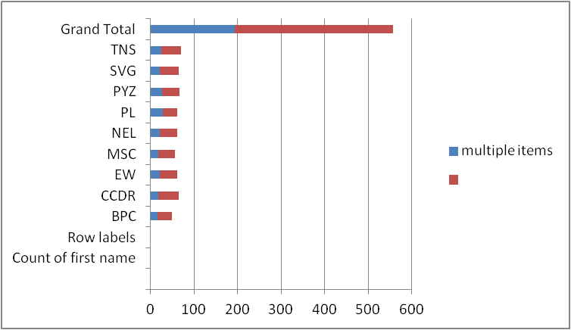
RESULT

Slide 12
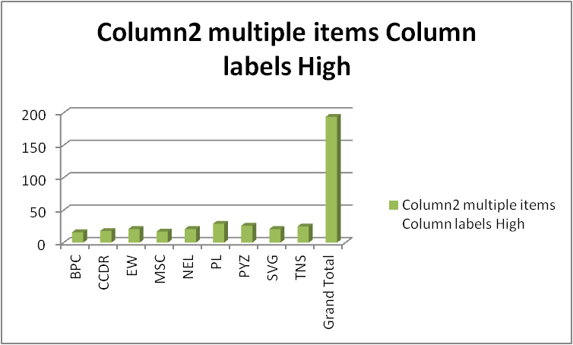

Slide 13
CONCLUSION
EMPLOYEE DATA ANALYSIS IS IMPORTANT IN AN ORGANISATION AND THUS IT HELPS TO ACHIEVE GOALS .THE PERFORMANCE SHOULD BE EVALUATED IN A WAY THAT THE EMPLOYEE DOES NOT FEEL INSECURITY AND IF PERFORMANCE IS NOT GOOD MEANS IT CAN BE DONE THROUGH MOTIVATING THE EMPLOYEE

